Slide 1

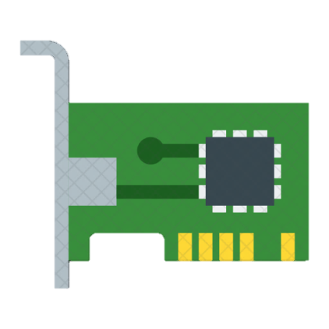

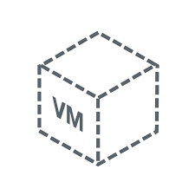






Architecture Diagram
VNET-01
VNET-02
192.123.0.0/16
172.165.0.0/24
Subnet-01
Subnet-02
Peering
Log in
VM-01
VM-02
OS VHD
Data VHD
Managed OS Disk
OS Disk
Data Disk
Managed Data Disk

